Slide 1
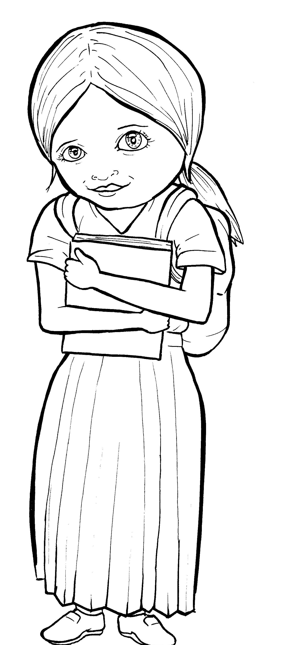

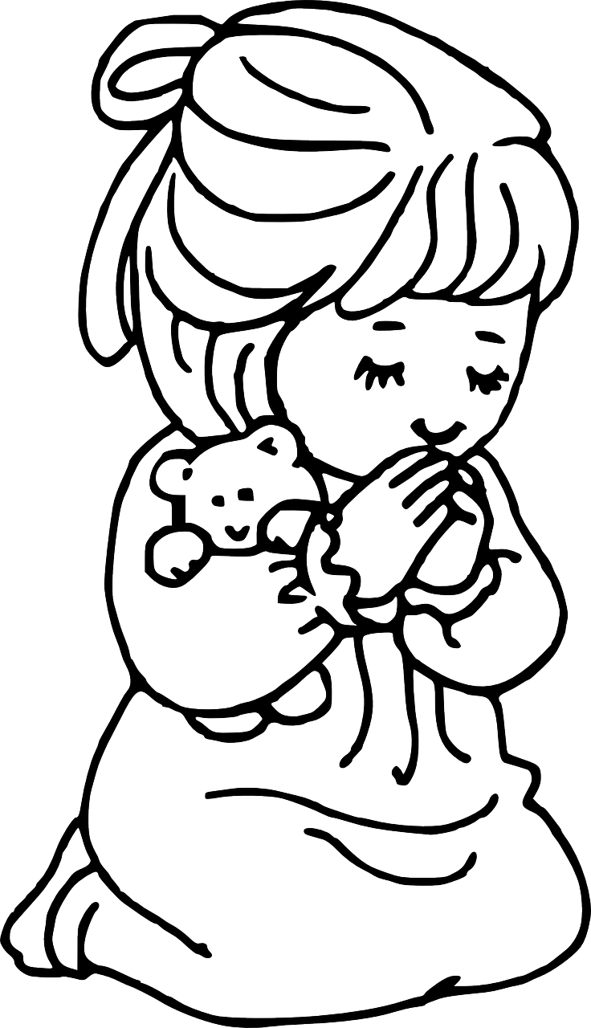
Part 2
49. Growing as a Christian
New Words
Rule Breakers

Slide 2
Silent Letters
know
through
Christian
talk

Slide 3
Possessives
Jesus’ life

Slide 4

Contractions
The word “contraction” means “the thing pulled together.”
The first word stays the same,
and the apostrophe takes the place of the
missing letters in the second word.
’m
=
am
I
I

Slide 5
can’t
=
can not
isn’t
is not
=

Slide 6
New Words
probably
through
believers

Slide 7

Rule Breakers
These words do not follow phonetic patterns.

Slide 8
is
who
to
the
do
you

Slide 9
your
their
eyes
there
give
want

Slide 10
what
other
friends
Father
loving
brothers

Slide 11
Christian
anywhere
through

